Slide 1

OMGT1039
Operations Management
Week 8
MRP and ERP

Slide 2
COMMONWEALTH OF AUSTRALIA
Copyright Regulations 1969
WARNING
This material has been reproduced and communicated
to you by or on behalf of Royal Melbourne Institute
of Technology, (RMIT University) pursuant to Part
VB of the Copyright Act 1968 (the Act).
The material in this communication may be subject to
copyright under the Act. Any further reproduction or
communication of this material by you may be the
subject of copyright protection under the Act.
Do not remove this notice.
First page of scanned document
This presentation includes selected slides from
William J Stevenson (2015) Operations Management, 12 ed. ISBN 10: 1259580091, McGraw Hill

Slide 3
Learning Objectives
You should be able to:
  Describe the master scheduling process and explain its importance
  Disaggregate an aggregate plan
  Describe the inputs, outputs, and nature of MRP processing
  Explain how requirements in a master production schedule are translated into material requirements for lower-level items
  Discuss the benefits and requirements of MRP
  Describe some of the difficulties users have encountered with MRP
  Describe MRP II
  Describe ERP, what it provides, and its hidden costs

Slide 4
Disaggregation
Aggregate
Plan
Disaggregation
Master
Schedule
MRP

Slide 5
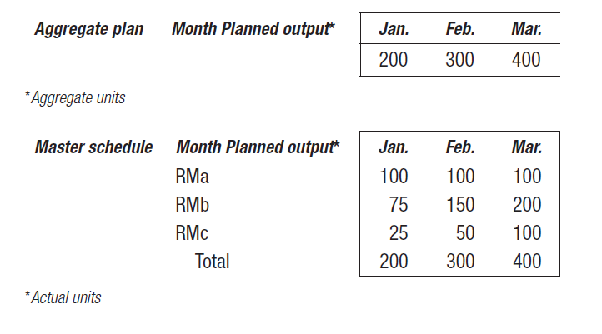
Disaggregating the Aggregate Plan
Master schedule:
  The result of disaggregating an aggregate plan
  Shows quantity and timing of specific end items for a scheduled horizon

Slide 6
Master Scheduling
The heart of production planning and control
  It determines the quantity needed to meet demand from all sources
  It interfaces with
    Marketing
    Capacity planning
    Production planning
    Distribution planning
  Provides senior management with the ability to determine whether the business plan and its strategic objectives will be achieved
  The master production schedule (MPS) is one of the primary outputs of the master scheduling process

Slide 7
MPS – Example
A company that makes industrial pumps wants to prepare a master production schedule for June and July. Marketing has forecasted demand of 120 pumps for June and 160 pumps for July. These have been evenly distributed over the four weeks in each month: 30 pumps per week in June and 40 pumps per week in July. Suppose that there are currently 64 pumps in inventory (i.e., beginning inventory is 64 pumps), and that there are customer orders that have been committed (booked) and must be filled as shown in next slide. The production lot size of 70 pumps. It means whenever the company decide to produce pumps the production lot should be 70 pumps.

Slide 8
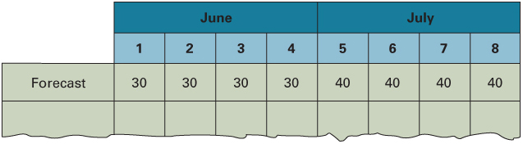
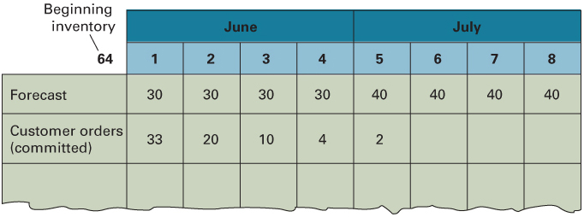
MPS – Forecasts and Customer Orders

Slide 9
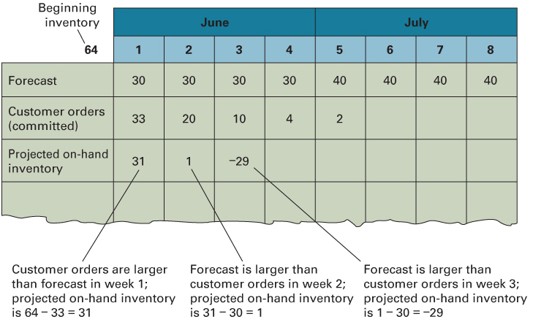

MPS – Projected On Hand
the current week’s requirements are the larger of forecast and customer orders (committed).

Slide 10
Determining MPS and
Projected On Hand
Week | Inventory from Previous Week | Requirements | Inventory before MPS | (70) MPS |  | Projected Inventory
1 | 64 | 33 | 31 |  |  |  | 31
2 | 31 | 30 | 1 |  |  |  | 1
3 | 1 | 30 | -29 | + | 70 | = | 41
4 | 41 | 30 | 11 |  |  |  | 11
5 | 11 | 40 | -29 | + | 70 | = | 41
6 | 41 | 40 | 1 |  |  |  | 1
7 | 1 | 40 | -39 | + | 70 | = | 31
8 | 31 | 40 | -9 | + | 70 | = | 61

Slide 11
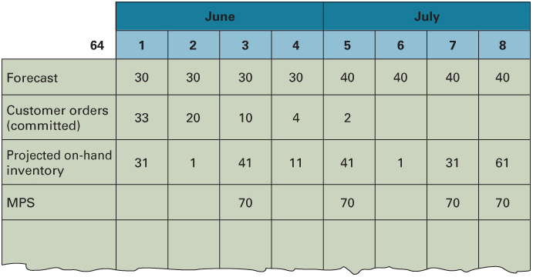
Adding MPS and Projected On Hand to the MPS

Slide 12
Material requirements planning (MRP)
  A computer-based information system that translates master schedule requirements for end items into time-phased requirements for subassemblies, components, and raw materials.
  The MRP is designed to answer three questions:
    What is needed?
    How much is needed?
    When is it needed?

Slide 13
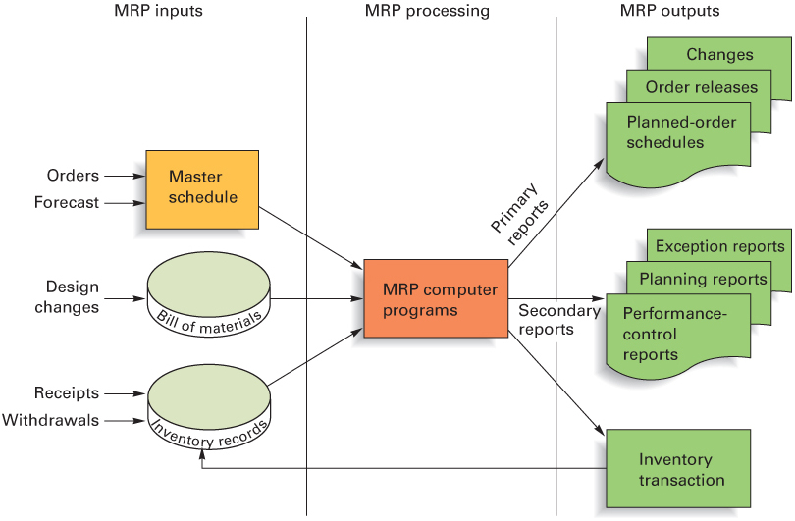
Overview of MRP

Slide 14
MRP Inputs: Master Schedule
Master schedule:
  One of three primary inputs in MRP; states which end items are to be produced, when these are needed, and in what quantities.
  The master schedule should cover a period that is at least equivalent to the cumulative lead time
      Cumulative lead time
        The sum of the lead times that sequential phases of a process require, from ordering of parts or raw materials to completion of the final assembly.

Slide 15
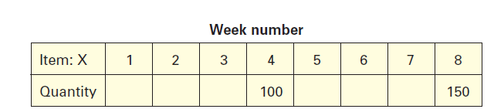
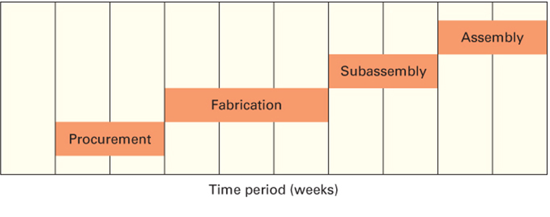
Cumulative Lead Time
Master Schedule
9 weeks
9 weeks

Slide 16
MRP Inputs: Bill of Materials
Bill of Materials (BOM)
  A listing of all of the assemblies, subassemblies, parts, and raw materials needed to produce one unit of a product
  Product structure tree
    A visual depiction of the requirements in a bill of materials, where all components are listed by levels

Slide 17
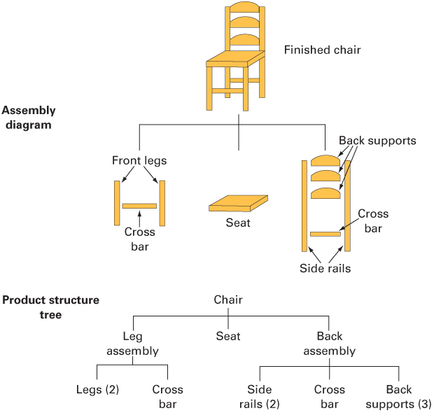
Assembly Diagram and
Product Structure Tree

Slide 18
MRP Inputs: Inventory Records
Inventory records
  Includes information on the status of each item by time period, called time buckets
    Information about
      Gross requirements
      Scheduled receipts
      Expected amount on hand
    Other details for each item such as
      Supplier
      Lead time
      Lot size policy
      Changes due to stock receipts and withdrawals
      Canceled orders and similar events

Slide 19
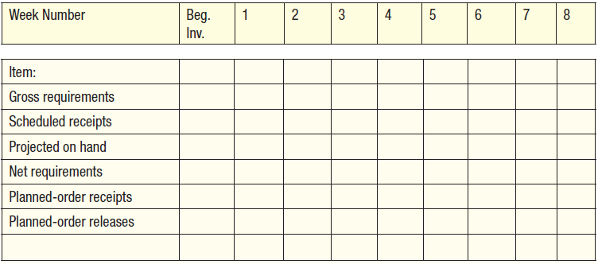
MRP PROCESSING
Gross requirements: The total expected demand for an item or raw material during
each time period without regard to the amount on hand.
Scheduled receipts: Open orders (orders that have been placed and are scheduled to arrive
from vendors or elsewhere in the pipeline by the beginning of a period).
Projected on hand: The expected amount of inventory that will be on hand at the beginning of each time period: scheduled receipts plus available inventory from last period.
Net requirements: The actual amount needed in each time period.
Planned-order receipts: The quantity expected to be received by the beginning of
the period.
Planned-order releases: Indicates a planned amount to order in each time period;

Slide 20
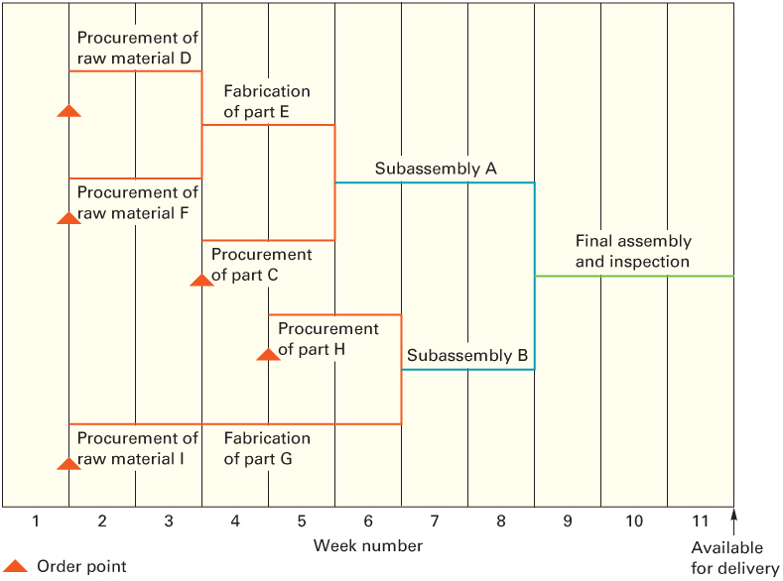
Assembly Time Chart

Slide 21
MRP: Example
A firm that produces wood shutters and bookcases has received two orders for shutters: one for 100 shutters and one for 150 shutters. The 100-unit order is due for delivery at the start of week 4 of the current schedule, and the 150-unit order is due for delivery at the start of week 8. Each shutter consists of two frames and four slatted wood sections. The wood sections are made by the firm, and fabrication takes one week. The frames are ordered, and lead time is two weeks. Assembly of the shutters requires one week. There is a scheduled receipt of 70 wood sections in (i.e., at the beginning of) week 1. Ordering/setup cost is $100 and holding cost is $0.10 per week. Determine the total cost, size and timing of planned-order releases necessary to meet delivery requirements under each of these conditions:
1. Lot-for-lot ordering (i.e., planned-order release equal to net requirements).
2. Lot-size ordering with a lot size of 320 units for frames and 70 units for wood sections.

Slide 22
MRP Example: Solution
First step: BOM
Shutter
Frames (2)
Wood sections (4)

Slide 23
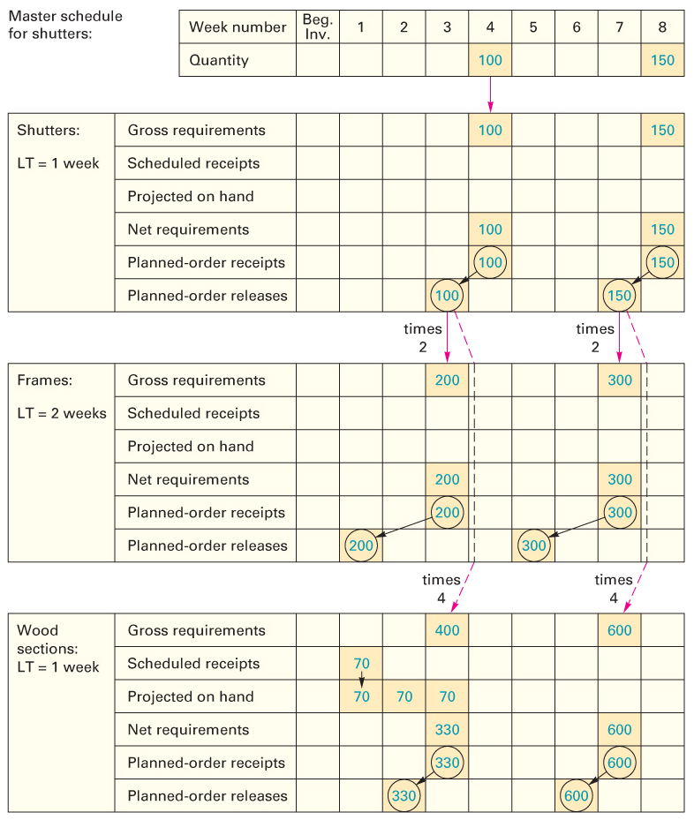
MRP Example:
1. Lot-for-lot ordering
MRP cost:
Ordering cost: 6 order * (100) = $600
Holding cost = (70+70+70)*0.1 = $21
Total cost = $621

Slide 24
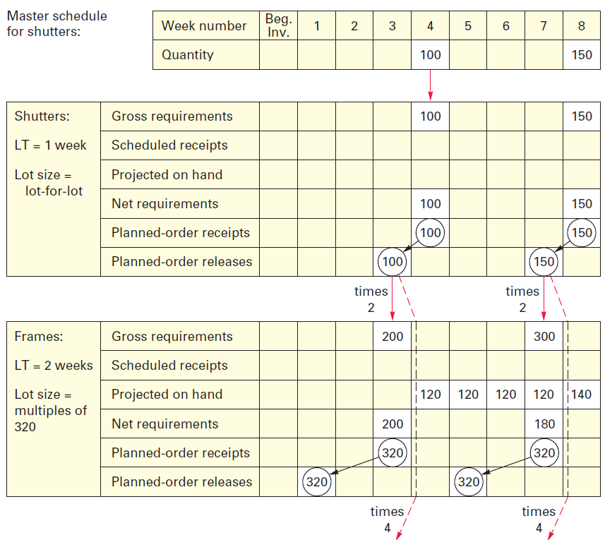
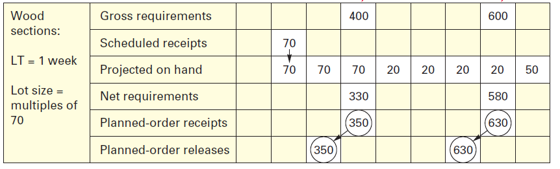
MRP Example:
2. MRP schedule with lot sizes of for components
MRP cost:
Ordering cost: 6 order * (100) = $600
Holding cost = (120+120+120+120+140+
70+ 70+ 70+ 20+ 20+ 20+ 20+ 50)*0.1= $96
Total cost = $696

Slide 25
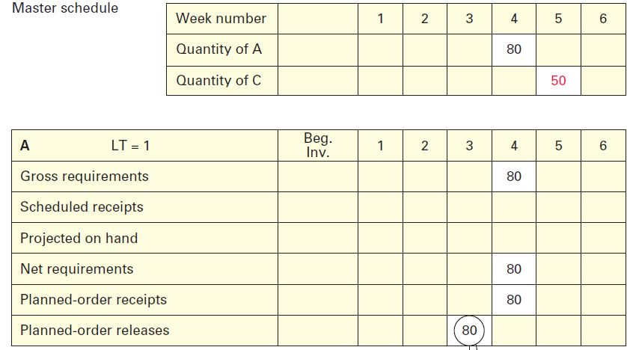
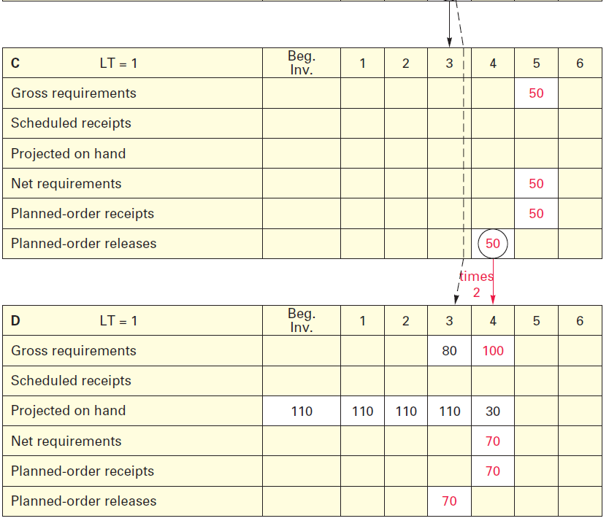
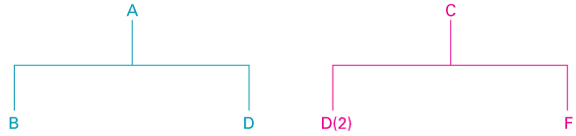
Pegging
The process of identifying the parent items that have generated a given set of material requirements for an item
Example for Pegging:
The demand for products A and C are 80 and 50 units in weeks 4 and 5, respectively. One unit of A needs one unit of D and one unit of C needs two unit of D. 110 unit of D is available in inventory. Lead time is 1 week. Use Lot for lot to complete MRP.

Slide 26
Other MRP Considerations:
Lot Sizing Rules
Lot-for-Lot (L4L) ordering
  The order or run size is set equal to the demand for that period
  Minimizes investment in inventory
  It results in variable order quantities
  A new setup is required for each run
Economic Order Quantity (EOQ)
  Can lead to minimum costs if usage of item is fairly uniform
    This may be the case for some lower-level items that are common to different ‘parents’
    Less appropriate for ‘lumpy demand’ items because inventory remnants often result
Fixed Period Ordering
  Provides coverage for some predetermined number of periods

Slide 27
MRP II
Manufacturing resources planning (MRP II)
  Expanded approach to production resource planning, involving other areas of the firm in the planning process and enabling capacity requirements planning
    Most MRP II systems have the capability of performing simulation to answer a variety of “what if” questions so they can gain a better appreciation of available options and their consequences

Slide 28
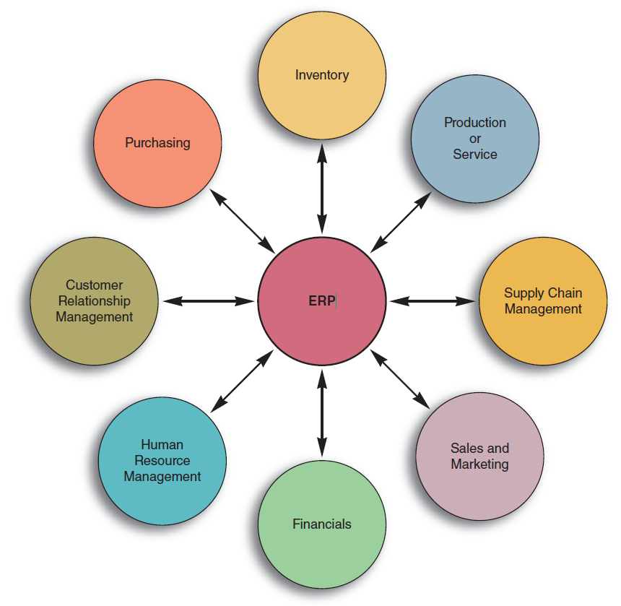
Enterprise Resource Planning
Enterprise resource planning (ERP)
  ERP was the next step in an evolution that began with MRP and evolved into MRPII
  ERP, like MRP II, typically has an MRP core
  ERP provides a system to capture and make data available in real time to decision makers and other users throughout an organization.
  ERP systems are composed of a collection of integrated modules

Slide 29
Overview of ERP Software Modules
Module | Brief Description
Accounting/Finance | A central component of most ERP systems. It provides a range of financial reports, including general ledger, accounts payable, accounts receivable, payroll, income statements, ad balance sheets
Marketing | Supports lead generation, target marketing, direct mail, and sales
Human Resources | Maintains a complete data base of employee information such as date of hire, salary, contact information, performance evaluations, and other pertinent information
Purchasing | Facilitates vendor selection, price negotiation, making purchasing decisions, and bill payment
Production Planning | Integrates information on forecasts, orders, production capacity, on-hand inventory quantities, bills of material, work in process, schedules, and production lead times
Inventory Management | Identifies inventory requirements, inventory availability, replenishment rules, and inventory tracking
Distribution | Contains information on third-party shippers, shipping and delivery schedules, delivery tracking
Sales | Information on orders, invoices, order tracking, and shipping
Supply Chain Management | Facilitates supplier and customer management, supply chain visibility, and event management

Slide 30
Questions

